Slide 1
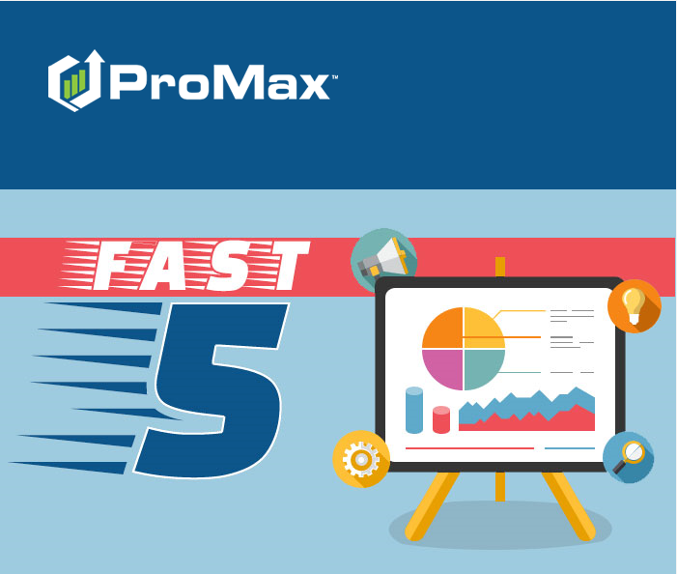
November

Slide 2
Agenda
Creating/Requesting New Lead Source
Uploading Photos in ProMax App
Texting with Emojis
Synthetic Fraud
“Activity Captured” Selection for Appointment Setting

Slide 3
Creating/Requesting New Lead Sources

Slide 4
Creating/
Requesting New Lead Sources
Whenever you start with a new lead provider, you will need to
  Make sure the lead provider is sending the leads to your ProMax lead importing address
  Make sure that they are sending in ADF/XML format
  Send over a test lead with all fields filled out to make sure they all parse as desired
  Let us know about the new lead source

Slide 5
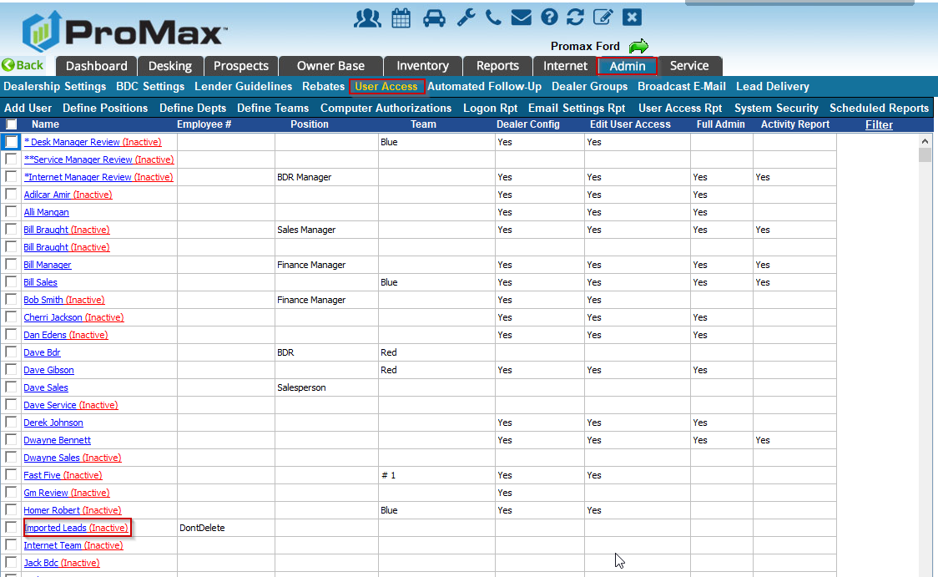
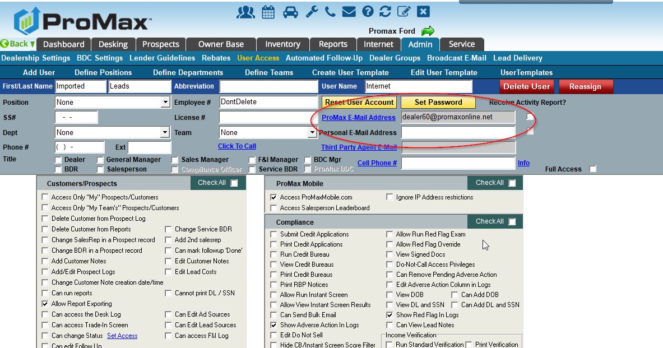
Creating/ Requesting New Lead Sources
Where can I find my lead importing address?
  Admin > User Access > Imported Leads > ProMax Email Address
  *** NOTE: This user should NEVER be edited or removed. Doing so can negatively impact lead importing

Slide 6
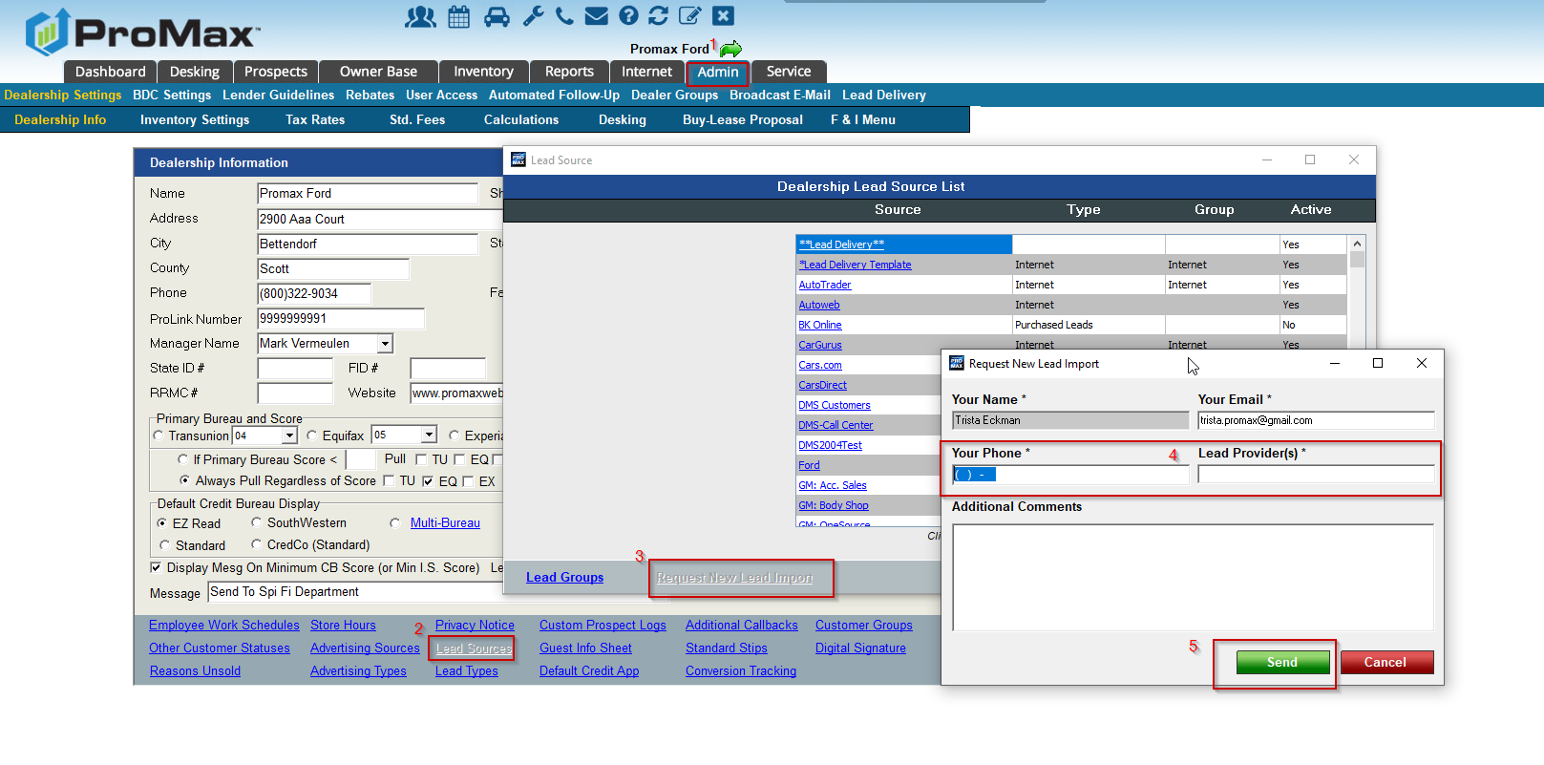
Creating/ Requesting New Lead Sources
How do I notify ProMax of a New Lead Source?
  Admin > Lead Sources > Request New Lead Source

Slide 7
“Activity Captured” Selection for Appointment Setting

Slide 8
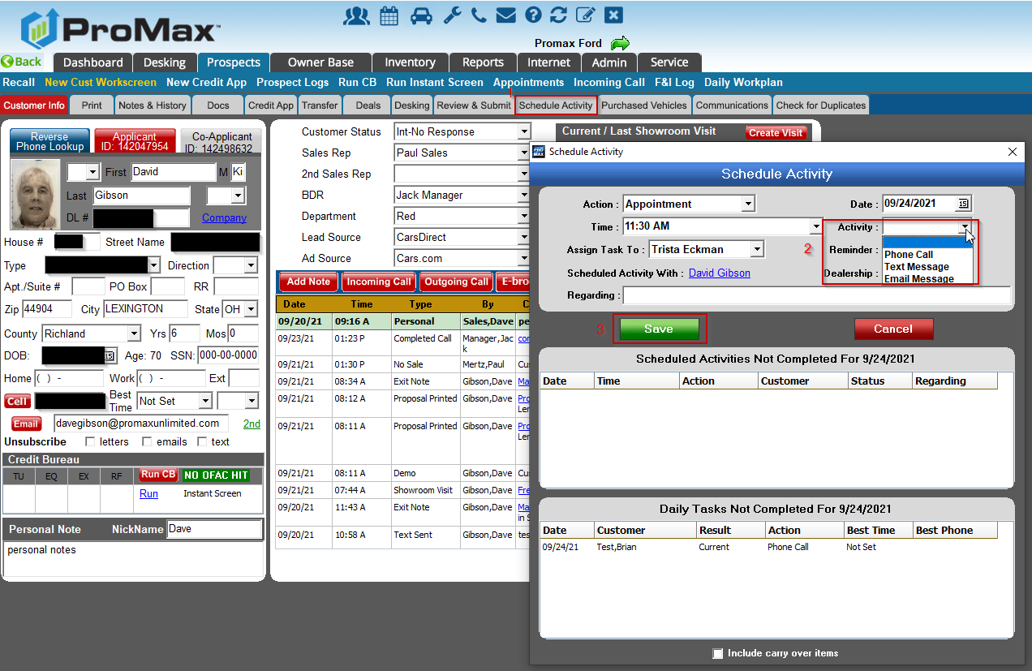
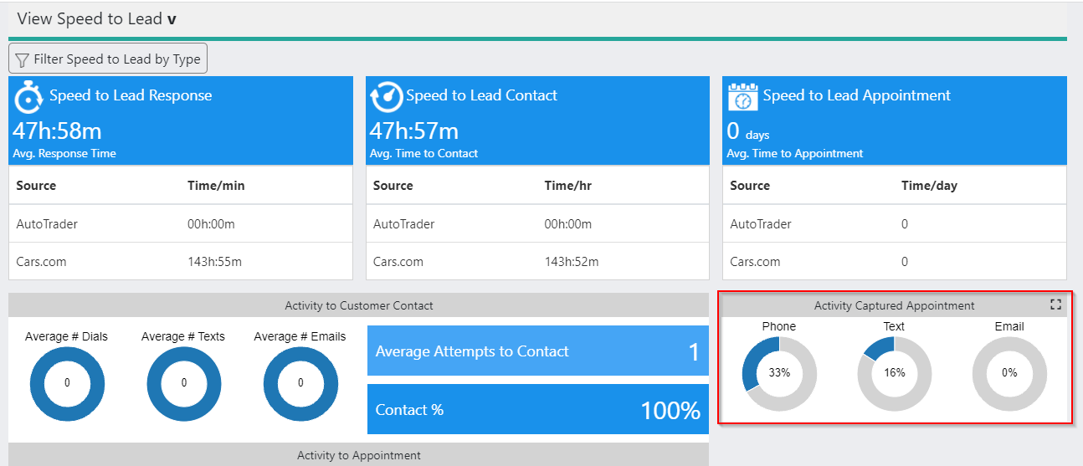
“Activity Captured” Selection for Appointments
This is a new feature that allows you to capture what activities are resulting in appointments. Having this information entered into the appointment setting screen will flow into the Store Traffic Report to give you a better understanding about what is working for your dealership.

Slide 9
Uploading Photos in the ProMax App

Slide 10
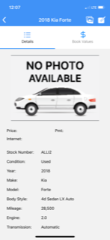
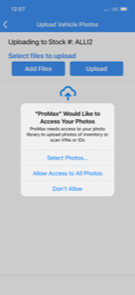
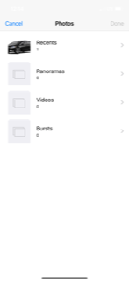
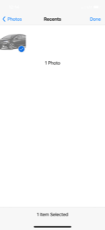
Uploading Photos in the ProMax App
You can now download the photos from your phone to Inventory records from the ProMax App.
Inventory > View/Recall/Create New > Select vehicle > Click on the Photo Icon.
Choose add files, select the photos from your library, hit done

Slide 11
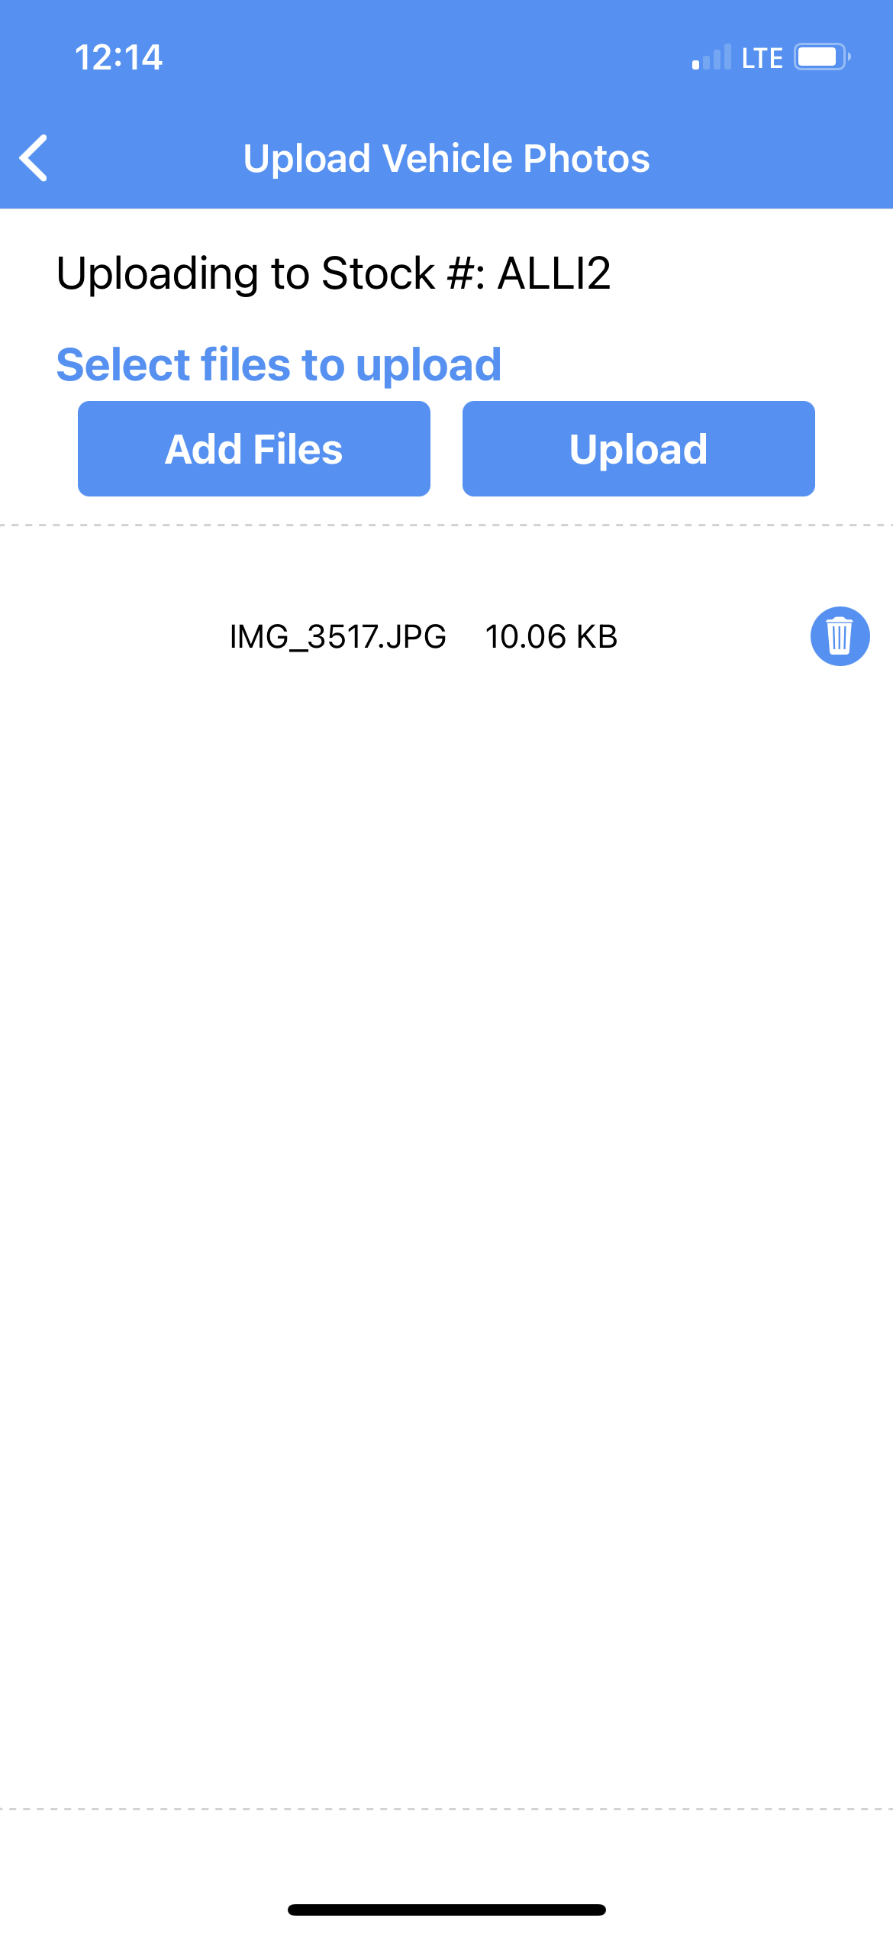
Uploading Photos in the ProMax App
Once your photos are added, hit upload. After the upload is complete it will show on your inventory record for you. This will show in the app, on the full version of ProMax and on ProMax mobile.
This is a good solution for just adding photos for a couple vehicles. However, if you have to upload photos for your entire lot, it is still best to do the import on the desktop version.

Slide 12
Texting with Emojis
ProMax allows you to text using emojis from the app

Slide 13

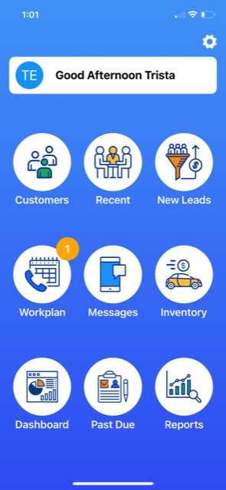
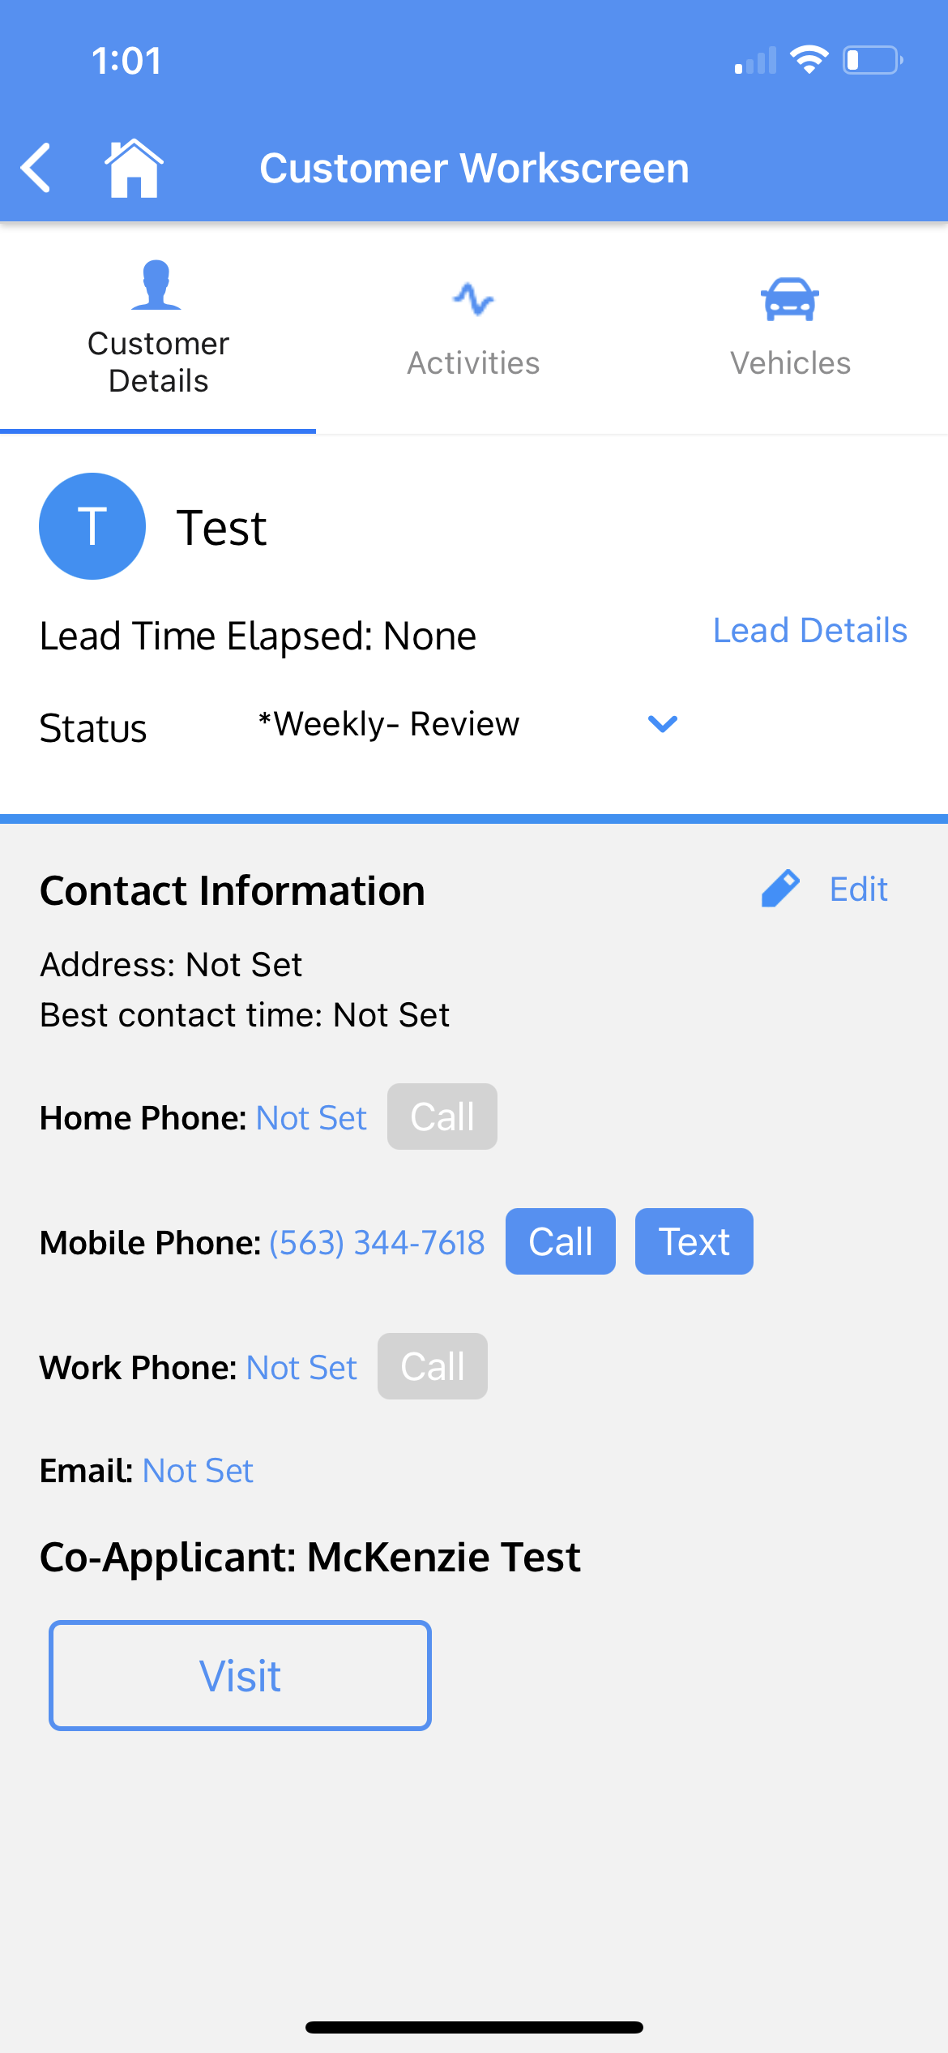
Texting with Emojis
Texting with Emojis is currently available through the app.
When you are on the app you can text from the “Messages” icon or straight from the customer workscreen.

Slide 14
Synthetic Fraud

Slide 15
Synthetic Fraud
Similarly to Red Flags, Synthetic Fraud is a tool to help you identify people who may be using fraudulent information from stolen information.
Synthetic fraud is relatively new to the automotive world. These bad actors take pieces of information from may different people to create a complete and fake credit file. They start building credit using department store credit cards for small amounts. Once they get a good credit score, they go in for a big purchase and ghost on the payments.
In ProMax, Synthetic Fraud will show at the top of all bureau reports once you sign up for this add on feature.

Slide 16
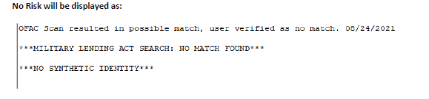
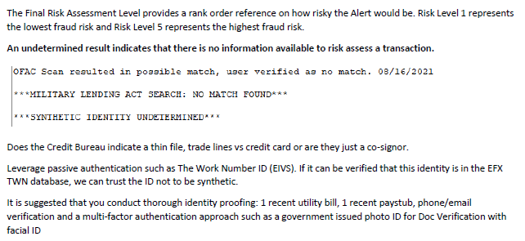
Synthetic Fraud
No Risk and Undetermined Risk

Slide 17
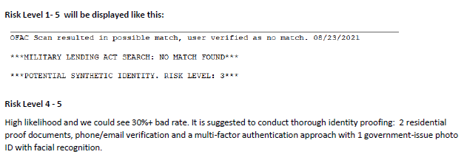
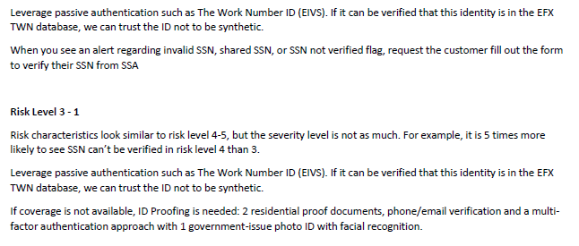
Synthetic Fraud
Risk Levels 1-5

Slide 18
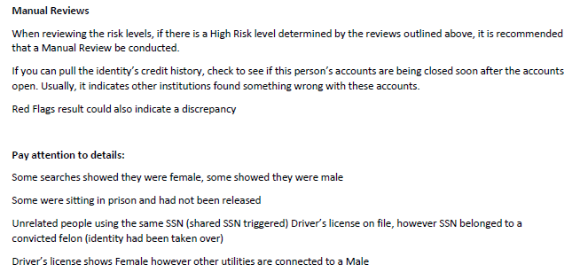
Synthetic Fraud
Doing your due diligence to confirm identity

Slide 19
Questions?
Contact our Dealer Support Line at 844-322-9034
Contact me directly at 563-344-7618 or Trista@ProMaxUnlimited.com
PromaxUnlimited.com
Facebook.com/ProMaxUnlimited
Twitter.com/ProMaxUnlimited
LinkedIn.com/Company/ProMax-Automotive-Software/
DealerUpdates.TypePad.com/Blog/

